Slide 1

Krono
By Team Leo
Mayank Singhal
Yash Gupta
Neelesh Verma

Slide 2
Problem Statement
To make an Android application that stores events related to classes, tutorials, events, etc. to deliver notifications, set reminders and also implement features like adding courses, getting institute events, silent mode during classes to aid IIT Bombay students.

Slide 3
FEATURES

Slide 4
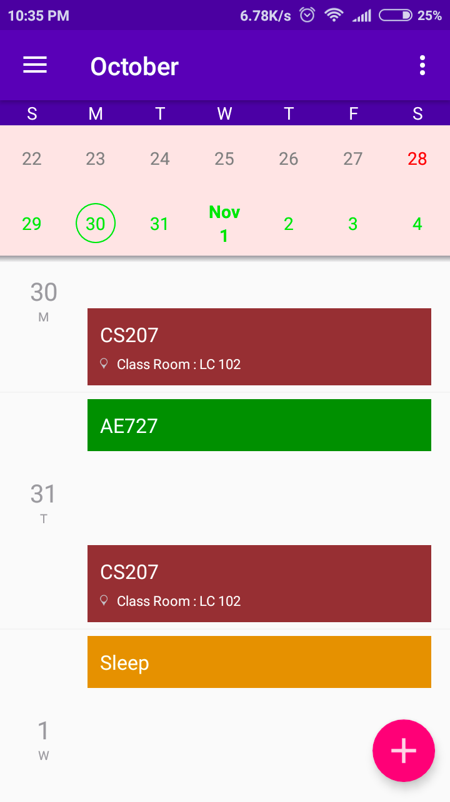
Agenda View shows all your events and reminders in one place.
Jump to a date by tapping on it.
Add events by tapping on the plus.

Slide 5
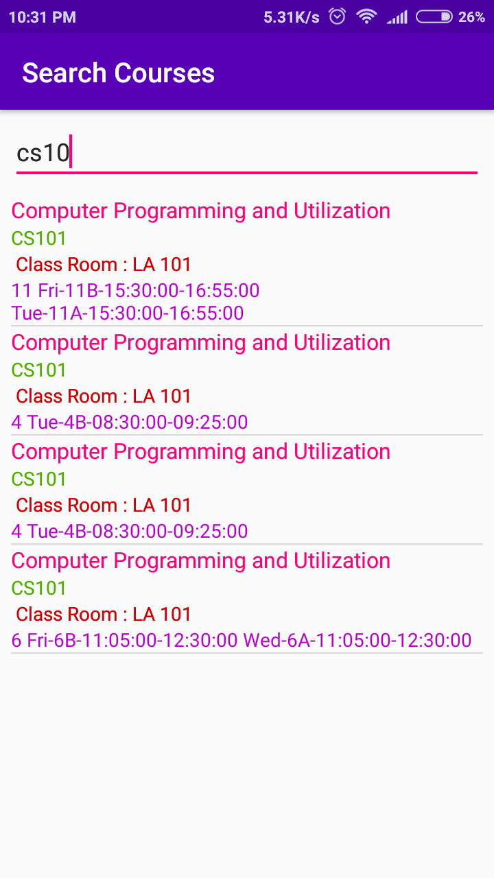
No need to painfully enter timings for classes.
Add IIT Bombay courses with one click.

Slide 6
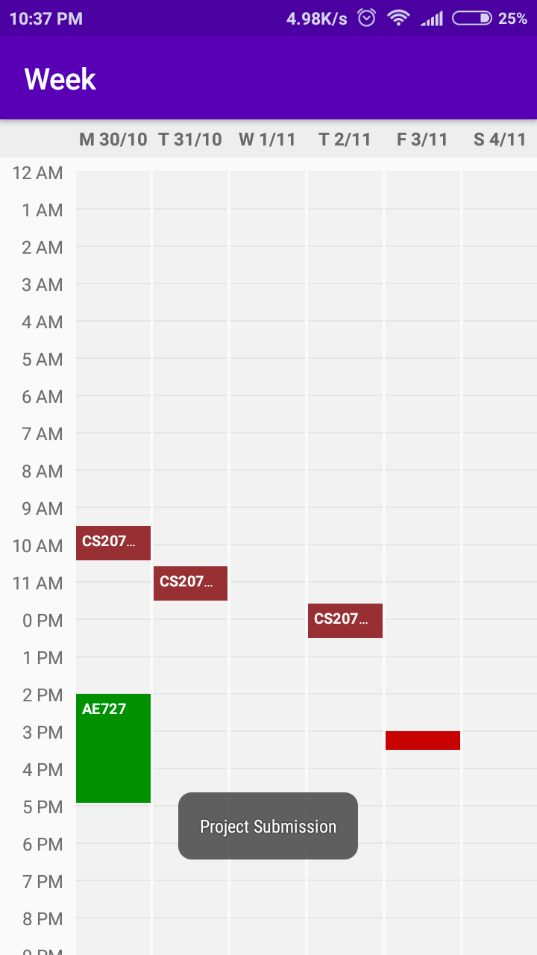
Provides an overview of a week with different color schemes for different types of events.

Slide 7
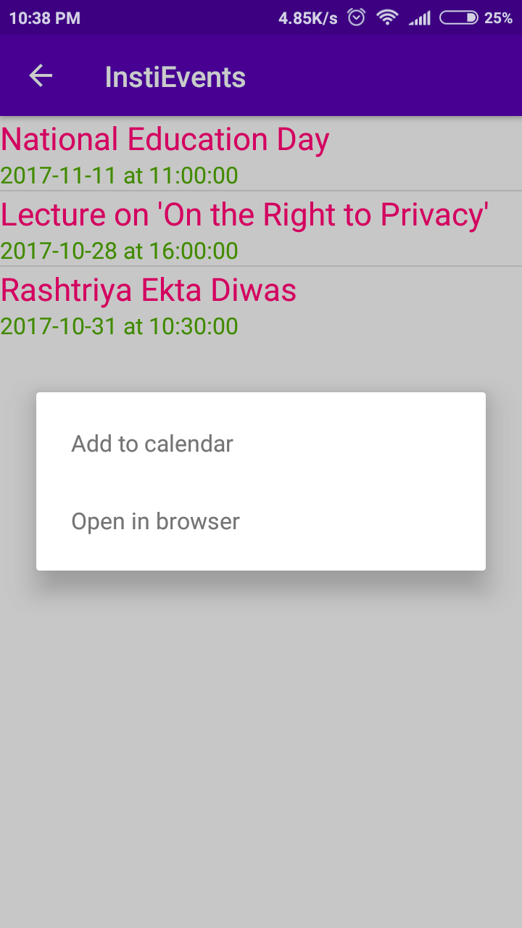
Add latest events from the institute’s web calendar to your phone.

Slide 8
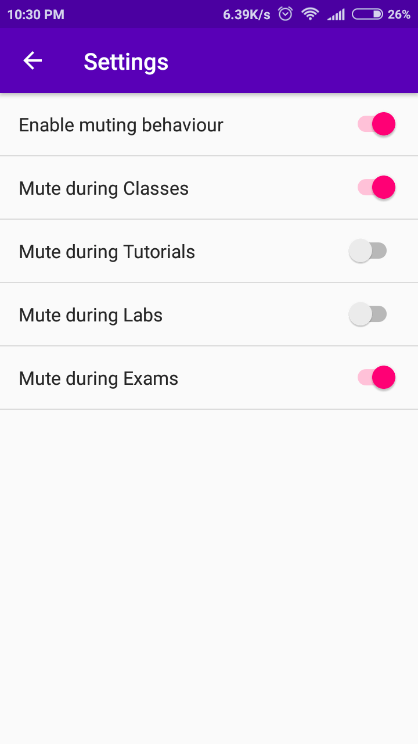
Now never worry about your phone ringing off in a lecture!
Automatically silences your phone during classes or exams.

Slide 9
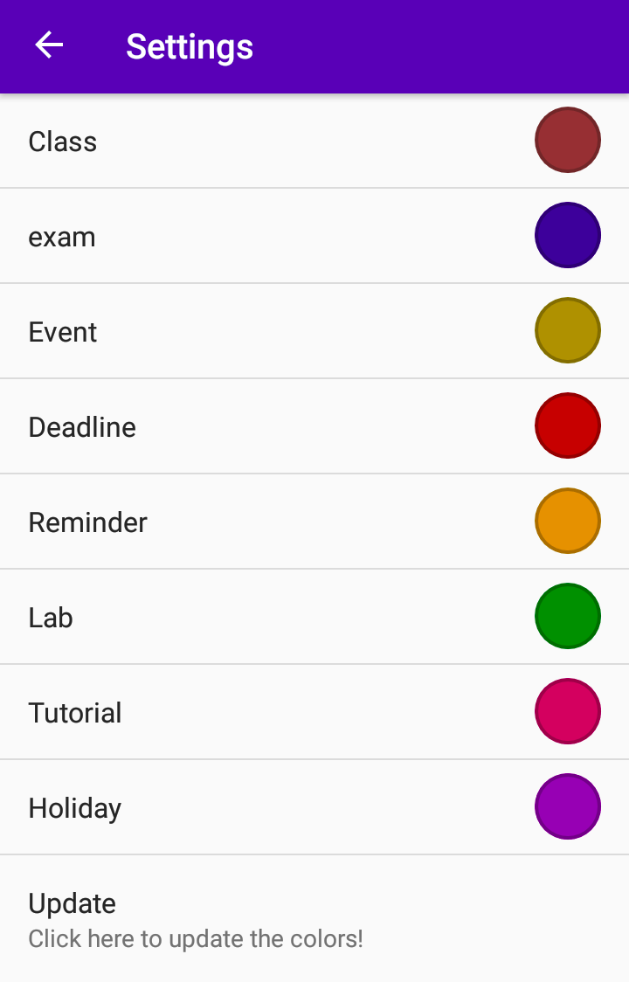
Make your calendar your own.
Choose your own colors for different events.

Slide 10
Motivation
No calendar app available in market specially designed for IIT Bombay students.
If available then lacking in some or all of these features:
  Categorization of events for students e.g., classes, exams, labs, user-created events etc.
  Adding IITB courses with one click.
  Making phone silent during classes.
  Holidays for IIT Bombay students.
  Adding Institute events to calendar.

Slide 11
Literature Survey
Some android apps like Google Calendar, Timetable have some of these functionalities - reminders and timetables.
Timetable app additionally provides keeping track of grades, switching the phone to silent mode during classes.
Studious app does provide some additional features like color-coding schemes.

Slide 12
Software And Hardware Requirements
Softwares
  Android Studio for developing the app
  SQLite for managing databases
  GIT for collaboration and version control
  Microsoft Azure Platform
  GNU tools like awk, sed etc
Programming Languages
  JAVA
  XML
  Python
Hardware
  Phone with Android 4.2 Jellybean or above

Slide 13
Implementation
Krono uses the Android Calendar Provider API to set reminders and create, and modify or delete events.
It stores data regarding courses in SQLite databases. User can query it from the app and add courses to his/her calendar.
It runs a background service which checks for events like classes or exams and automatically silences the phone if needed.
It connects to web scraper deployed on Microsoft Azure that periodically scrapes events from the web calendars.

Slide 14
THANK YOU

